Slide 1




Tech Talk

Slide 2



Objective
Insight over Java Memory Model
Knowledge on JavaProfiling & Finding Memory Leaks
Coding with Clear Vision on Memory Leaks

Slide 3
Significant Items Covered
Java (JVM) Memory Model
Garbage Collection in detail
Profiling

Slide 4
Agenda
Java (JVM) Memory Model
Pre Java 8 Vs Java 8
Java Heap Memory Switches
Java Heap & Stack
Garbage Collection
Java VisualVM with Visual GC

Slide 5
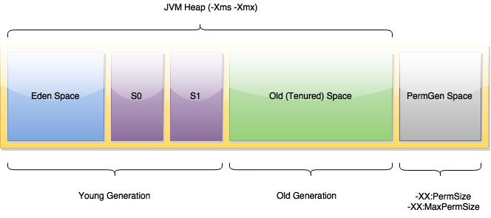
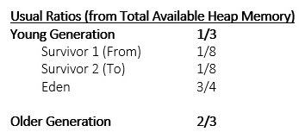
Java (JVM) Memory Model

Slide 6
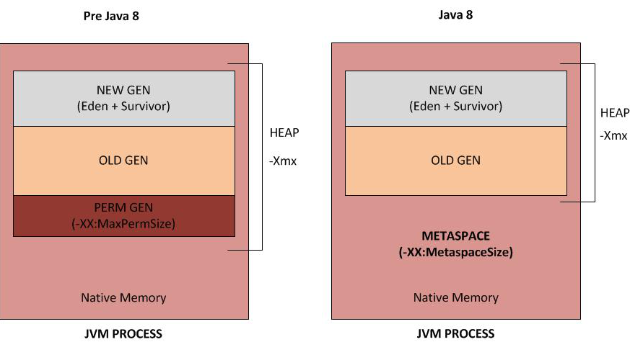
Memory Model Java 8 Vs Pre Java 8

Slide 7
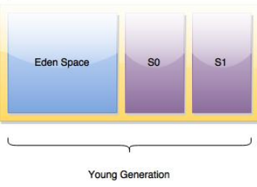
Young Generation
Where new Objects are created
MinorGC - Young Gen GC
Have three Portions such as
  Eden
  Survivor 0
  Survivor 1
Most of the newly created objects are located in the Eden memory space.
When Eden space is filled with objects, Minor GC is performed and all the survivor objects are moved to one of the survivor spaces.
Minor GC also checks the survivor objects and move them to the other survivor space. So at a time, one of the survivor space is always empty.
Objects that are survived after many cycles of GC, are moved to the Old generation memory space.

Slide 8
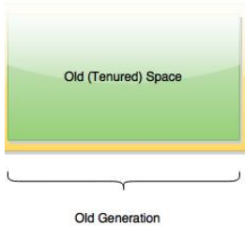
Old Generation
Where long lived objects are kept
MajorGC - Old Gen GC
Stop the World Event happens during MajorGC
Major GC stops all application threads until GC operation completes.
Major GC takes longer time because it checks all the live objects.
Major GC should be minimized because it will make your application unresponsive for the garbage collection duration.
You may notice time-out erros when your app is Responsive & has More MajorGC ops.

Slide 9
MetaSpace - Memory Area other than Heap
Permanent Generation - Mainly for Constant Pool (Memory Pool), Field & Method Data and Code
Permanent Generation or “Perm Gen” contains the classes & J2SE library classes used by the application.
Perm Gen is not part of Java Heap memory.
Perm Gen objects are garbage collected in a full garbage collection.
Method Area
Method Area is part of space in the Perm Gen and used to store class structure (runtime constants and static variables) and code for methods and constructors.
(Runtime constant pool is the part of method area)
Memory Pool
Memory Pools are created by JVM memory managers to create a pool of immutable objects.
(String Pool is a good example of this kind of memory pool)
Memory Pool can belong to Heap or Perm Gen, depending on the JVM memory manager implementation.

Slide 10
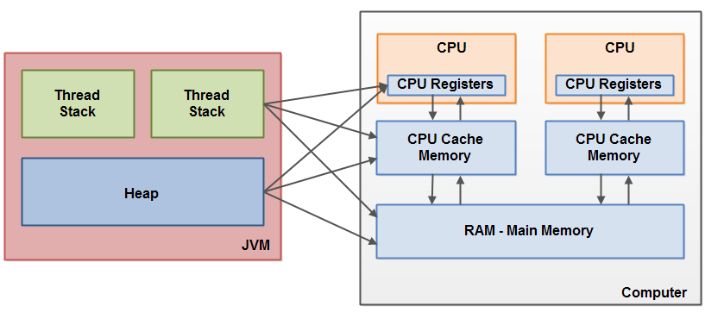
JVM Memory Model with System

Slide 11
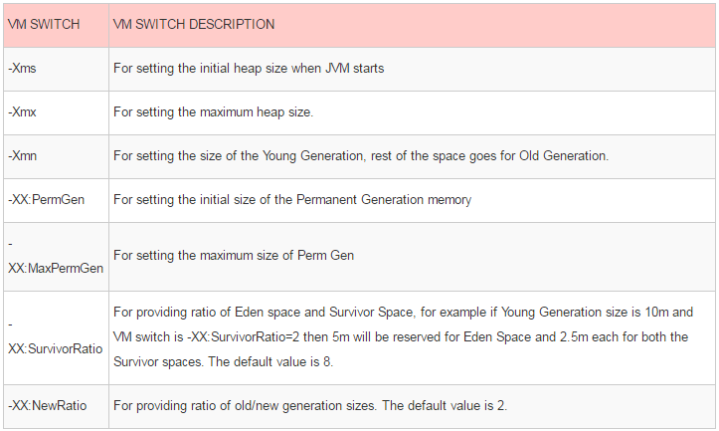
Java Heap Memory Switches
More VM Options

Slide 12
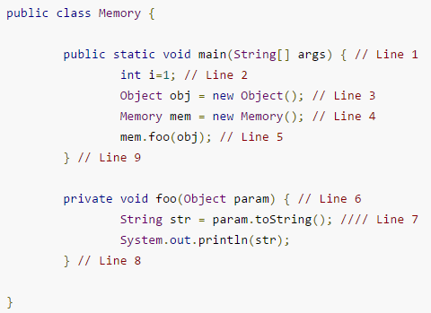
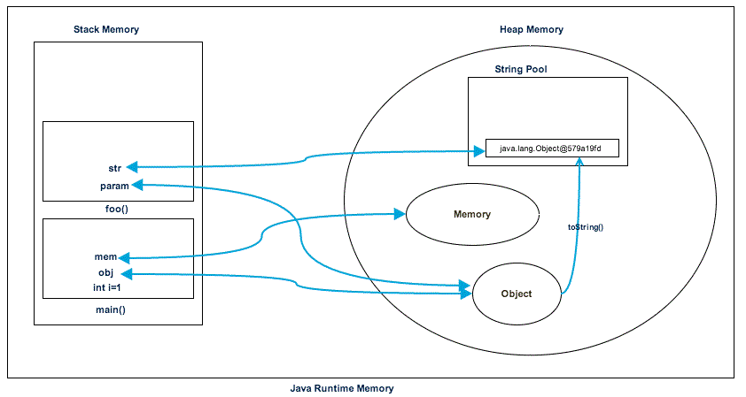
Java Heap Space vs Stack – Memory Allocation in Java
Java Heap Space -
a) Used for runtime Objects
b) Object created in heap has Global access & referenced from anywhere of the application.
Java Stack Space -
a) used for execution of a thread
b) Contain method specific values, primitives, other static variables & String variables (references)

Slide 13
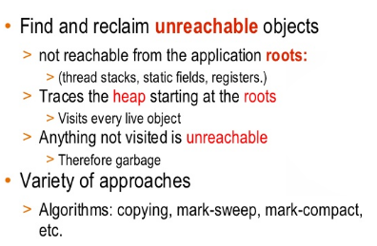
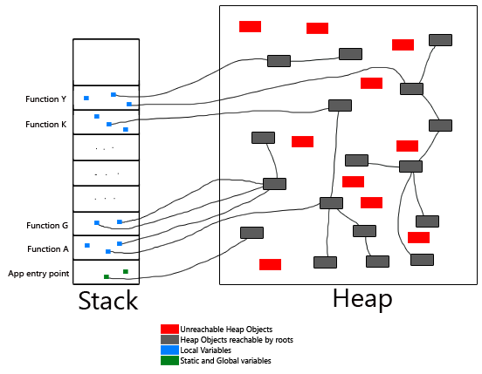
Java Garbage Collection

Slide 14
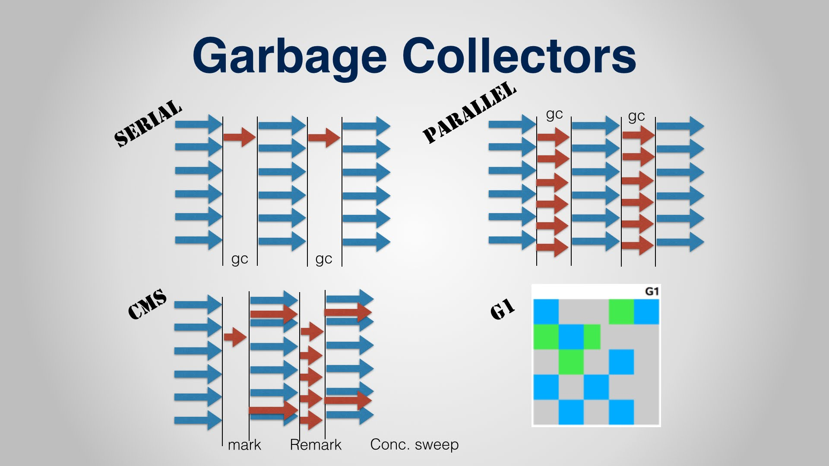
Diagrametic representation of Garbage Collection Algorithms

Slide 15
Garbage Collection Algorithms
Serial GC (-XX:UseSerialGC):
Use the simple mark-sweep-compact cycle
  Mark - Identify unused
  Sweep - Removes & Reclaim free space
  Compacting - Moving Survived objects to Survivor
good for client systems and systems with low memory footprint and smaller CPU
Parallel GC (-XX:UseParallelGC):
This uses N threads, which can be configured using -XX:ParallelGCThreads=N, here N is also the number of CPU cores for garbage collection. It uses these N threads for GC in the Young Generation but uses only one-thread in the Old Generation.
Parallel Old GC (-XX:UseParallelOldGC):
This is same as the Parallel GC, except that it uses N threads for GC in both Old and Young Generation.
Concurrent Mark and Sweep GC (-XX:ConcMarkSweepGC): only on OLD
CMS GC minimzes the pauses that are required for GC. It is most useful when used to create highly responsive applications and it does GC only in the Old Generation. It creates multiple threads for GC that work concurrently with applications threads, which can be specified using the -XX:ParallelCMSThreads=n.
G1 GC (-XX:UseG1GC):
This is a parallel, concurrent, and incrementally compacting low-pause garbage collector. G1 was introduced in Java 7 with the ultimate vision to replace CMS GC. It divides the heap into multiple, equal sized regions and then performs GC, usually starting with the region that has less live data, hence "Garbage First".

Slide 16
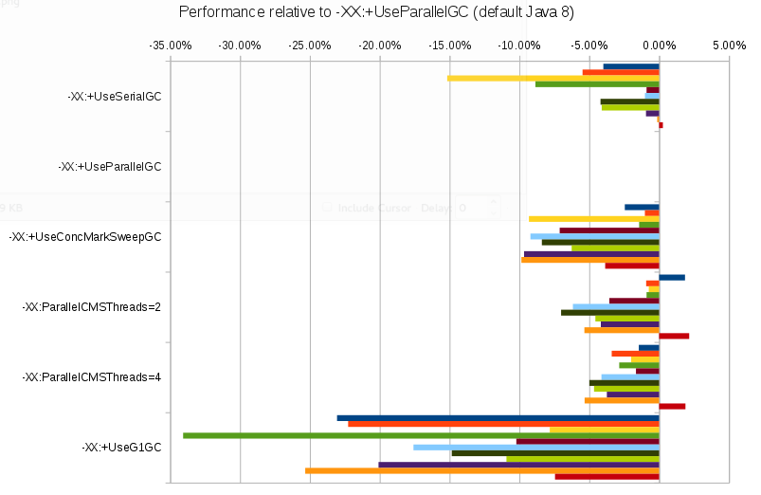
That default (Parallel GC) is the fastest.

Slide 17
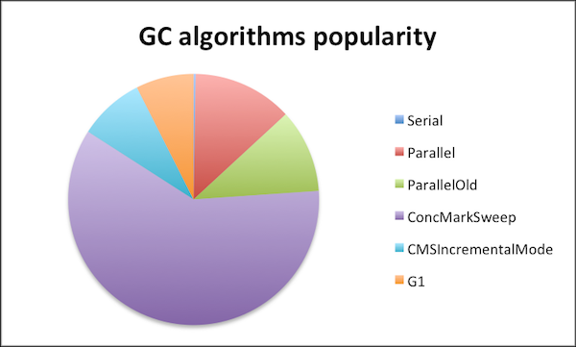

Slide 18

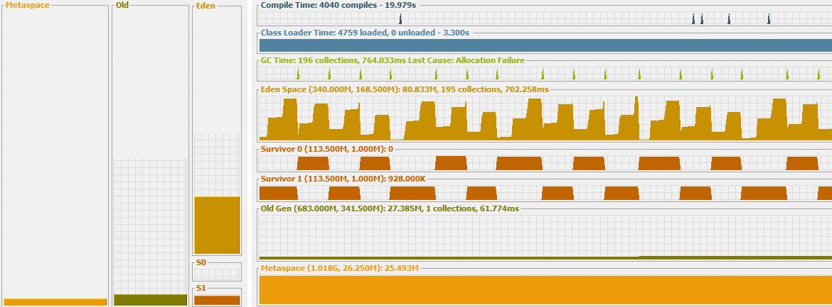
Visual VM
Visual GC

Slide 19
Thank You
By
Arul

